Slide 1
Welcome

Slide 2
A Major Project Seminar
On
“Machine Learning based Aadhar Card and Driving license data extraction in database”
Submitted by
Mohammed Furqan – 17T81A0512
Mothkur Akhil – 17T81A0502
C. Hema – 17T81A0516
Kakirala Harshitha – 17T81A0515
Internal Guide:-M. Archana

Slide 3
1. INTRODUCTION
1.1 Introduction :-
Applying Machine Learning algorithms to biometric identification system is one of the emerging AI trends. In our case, the client has an automated identity verification system. It is running a comprehensive match, by comparing an official document such as a driver’s license with a photo (selfie).
Optical character recognition (OCR) is a process by which specialized software is used to convert scanned images of text to electronic text so that digitized data can be searched, indexed and retrieved.
In other words, OCR systems transform a two-dimensional image of text, that could contain machine printed or handwritten text from its image representation into machine-readable text.
This technology began with the scanning of books, text recognition and hand-written digits (NIST datasets). Detecting printed text is somewhat different, as identifying texts “in the wild”, such as road signs, license plates or outdoor advertising signs, is decidedly more difficult.

Slide 4
1. INTRODUCTION
OCR is commonly used for optimization and automation. Some examples are checking test answers, real-time translations, recognizing street signs (Google Street View) and searching through photos (Dropbox). For each case a completely different OCR solution is used.
1.2 Existing System
In the running world there is a growing demand for the users to convert the printed documents in to electronic documents for maintaining the security of their data. Hence the basic OCR system was invented to convert the data available on papers in to computer process able documents, So that the documents can be editable and reusable.
1.3 Disadvantage of Existing System
Older Systems are less accurate.
They cannot understand type of data.
They cannot classify the data.

Slide 5
2 PROPOSED SYSTEM
2.1 Proposed System
Our Project implement OCR integrated with Document classification in it. Hence the OCR will not only extract the information from the document but understand it accurately. Moreover, all the extracted information will be stored in dedicated databases and all the databases can be searched and scanned for available information. The Extracted Information will be used to Automate Student Registration Process which will make the process Faster.

Slide 6
2 PROPOSED SYSTEM
2.2 Advantages
Information of OCR can be readable with high degree of accuracy. Flatbed scanners are very accurate and may produce reasonably top quality images.
Processing of OCR information is fast. Large quantities of text are often input quickly.
A paper based form are often became an electronic form which is straightforward to store or send by mail.
It is cheaper than paying someone amount to manually enter great deal of text data. Moreover it takes less time to convert within the electronic form
Advanced version can even Re create tables, columns and even produce sites.

Slide 7
3 Real Time Applications
3.1 Real Time Applications
Extracting data from business documents
Bank Checks,
passports,
Invoices,
Bank statements,
Insurance documents,
License plates and more

Slide 8
4. REQUIREMENTS
4.1 Hardware Requirements
Processor :- i3 Latest generation and above
RAM :- 4 GB Minimum
SSD :- 512 GB
4.2 Software Requirements
Operating System :- Windows 10
Interpreter :- Python
Setup :- tesseract-ocr
Database :- SQLite3 Browser
Python Modules :- numpy, pandas, tensorflow, pytesseract, nltk,

Slide 9
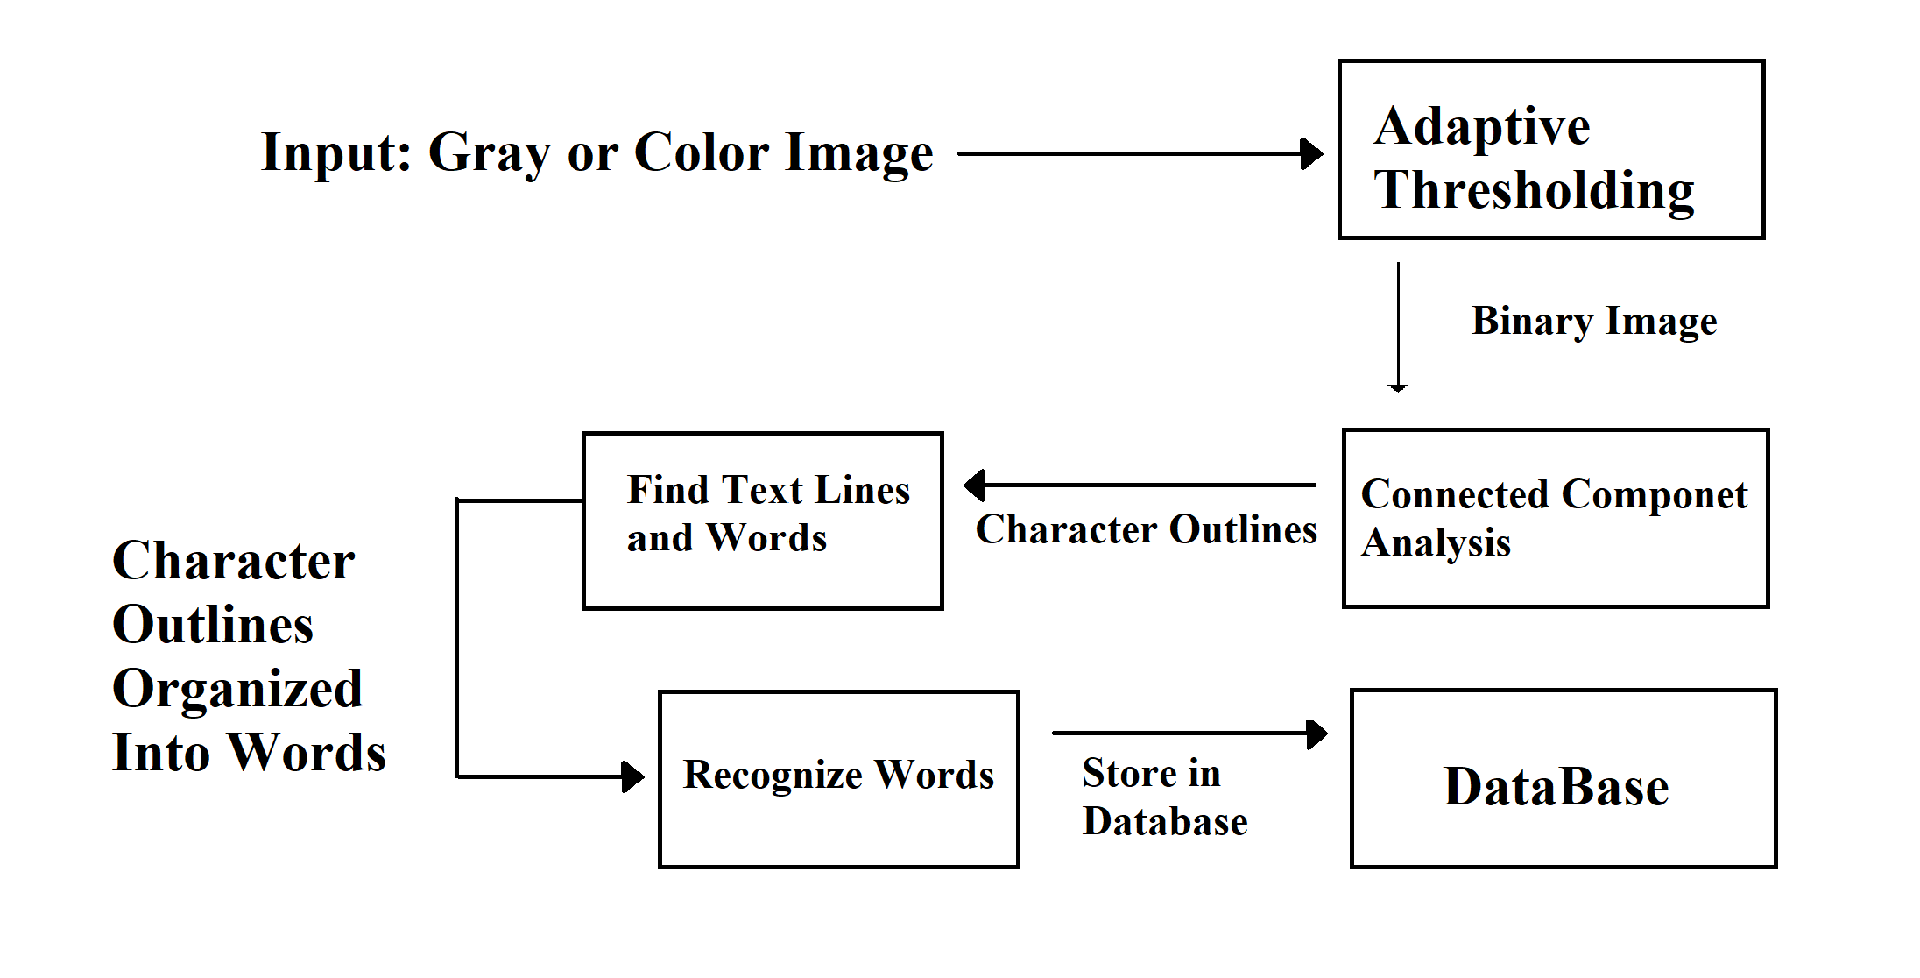
5. ARCHITECTURE
5.1 Architecture
Figure 5.1 Data Recognizing and Storing data in Database Architecture

Slide 10
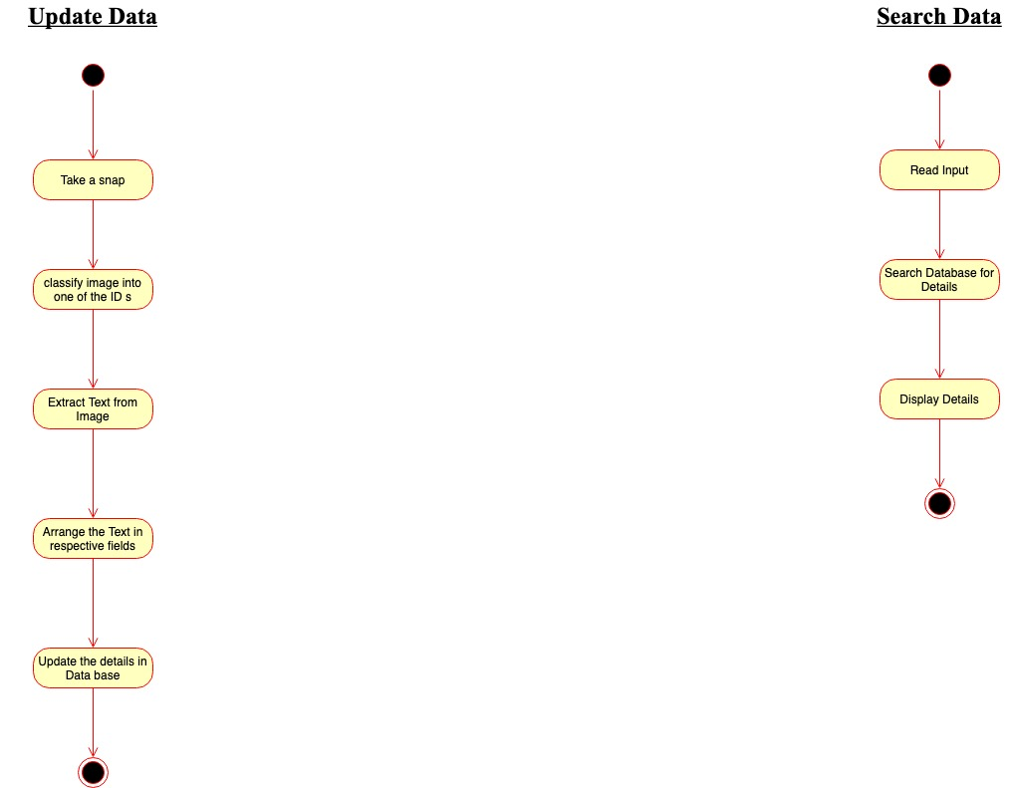
6. ALGORITHM
6.1 Update Data Algorithm
Step 1:- Take a snap of Aadhar Card / Driving License.
Step 2:- Classify image with one of the ID's
Step 3:- Extract Text from Image.
Step 4:- Arrange the Text in respective fields.
Step 5:- Update the details in Data base.
Figure No. 6.1 Update Data Algorithm

Slide 11
6. ALGORITHM
6.2 Search Data Algorithm
Step 1:- Read the given input
Step 2:- Search Database for Details
Step 3:- Display Details
Figure No. 6.1 Update Data Algorithm

Slide 12
7. MODULES
7.1 CV2
CV2 is a cross-platform library using which we can develop real-time computer vision applications. It mainly focuses on image processing,
Method loads an image from the specified file. If the image cannot be read (because of missing file, improper permissions, unsupported or invalid format) then this method returns an empty matrix.
7.2 Pytesseract
Python-tesseract is an optical character recognition (OCR) tool for python. That is, it will recognize and “read” the text embedded in images.
Python-tesseract is a wrapper for Google’s Tesseract-OCR Engine. It is also useful as a stand-alone invocation script to tesseract, as it can read all image types supported by the Pillow and Leptonica imaging libraries, including jpeg, png, gif, bmp, tiff, and others.

Slide 13
7. MODULES
7.3 Numpy
NumPy is the fundamental package for scientific computing in Python.
It is a Python library that provides a multidimensional array object, various derived objects (such as masked arrays and matrices), and an assortment of routines for fast operations on arrays, including mathematical, logical, shape manipulation, sorting, selecting, I/O, discrete Fourier transforms, basic linear algebra, basic statistical operations, random simulation and much more.
7.4 Pandas
Pandas is an open source Python package that is most widely used for data science/data analysis and machine learning tasks
s, Pandas works well with many other data science modules inside the Python ecosystem, and is typically included in every Python distribution, from those that come with your operating system to commercial vendor distributions like ActiveState’s ActivePython

Slide 14
7. MODULES
7.5 SQLite3
Creation of Tables to store the scanned data.
There are 2 Different tables for Aadhar Card and Driving License

Slide 15
8. CONCLUSION
8.1 Conclusion
Machine learning based Document Scanning and recognition is a very remarkable technology that holds a lot of potential. In this day and age, such tools are already quite advanced. However, Optical Character Recognition is going to look even better in the future
8.2 Future Scope
Machine learning based Document is finally moving away from just seeing and matching. Driven by deep learning, it's entering a new phase where it first recognizes scanned text, then makes meaning of it. The competitive edge will be given to the software that provides the most powerful information extraction and highest-quality insights
8.3 Limitation.
All the documents got to be checked over carefully then manually corrected.
Many OCR engines fail to support and understand the complexity of the input data in a given document. For example, if the input document is a form then the OCR might identify the text but may not recognize text over a line or the text in blocks. This may result in unexpected output.

Slide 16
9. REFERENCES
8.1 References
https://www.slideshare.net/100002968637682/ocr-using-tesseract
https://www.cloudfactory.com/machine-learning/optical-character-recognition-ocr
https://towardsdatascience.com/a-gentle-introduction-to-ocr-ee1469a201aa
https://nanonets.com/blog/ocr-with-tesseract/
https://mobidev.biz/blog/ocr-machine-learning-implementation
https://www.slideshare.net/IAMINURHEARTS1/ocr-ppt-35272335

Slide 17
Thank you

